Slide 1
AGRO-CONNECT
211701040 – RAGAVI K
211701041 – RAKSHANA A

Slide 2
Problem Statement
2
Introducing Agro-Connect: a revolutionary social platform poised to transform the agricultural landscape. In an era where connectivity is paramount, Agro-Connect emerges as a beacon of innovation, bridging the gap between farmers, cultivators, and enthusiasts worldwide. Our platform recognizes the diverse needs and challenges faced by individuals across various agricultural domains, including agriculture, pisciculture, apiculture, and horticulture. By offering a centralized hub for knowledge exchange, collaboration, and commerce, Agro-Connect seeks to empower farmers with the tools and resources they need to succeed in an ever- evolving industry.

Slide 3
Objectives
3
Foster Knowledge Exchange and Collaboration
Empower Farmers with Resources and Tools
Cultivate a Vibrant and Supportive Community
Provide Comprehensive Disease Prevention Resources
Promote Sustainability and Resilience in Agriculture

Slide 4
Proposed System
Advanced Data Analytics
Enhanced Connectivity
Multilingual Support
E-commerce Capabilities
Sustainability Initiatives

Slide 5
Advantages Of Proposed System
Enhanced Market Access
Rapid Problem Solving
Skill Development
Networking and Collaboration
Resilience and Sustainability

Slide 6
Limitations
Limited Market Access
Delayed Problem Solving
Skill Stagnation
Networking Challenges

Slide 7
Literature Survey (Technology)
4
S.No | Title of the paper/Year of publication | Methodology Proposed | Limitations
1 | Application of planning models in the agri-food supply chain | The supply chain of agricultural products has received a great deal of attention lately due to issues related to public health. Something that has become apparent is that in the near future the design and operation of agricultural supply chains will be subject to more stringent regulations and closer monitoring, in particular those for products destined for human consumption (agri-foods). | Data Privacy Risks. Digital Divide

Slide 8
Literature Survey (Technology)
4
S.No | Title of the paper/Year of publication | Methodology Proposed | Limitations
1 | Big Data and Smallholder Farmers: Big Data Applications in the Agri-Food Supply Chain in Developing Countries | The potential of big data (BD) applications in agriculture is attracting a growing interest from food and agribusiness industry players, researchers, and policy makers. Possible gains in agricultural productivity and supply chain efficiency from BD-based solutions can help address the challenge of doubling the food supply by 2050. | Accessibility Challenges. Dependence on Technology

Slide 9

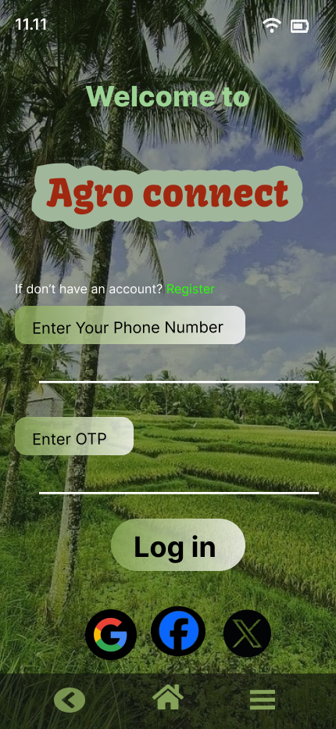
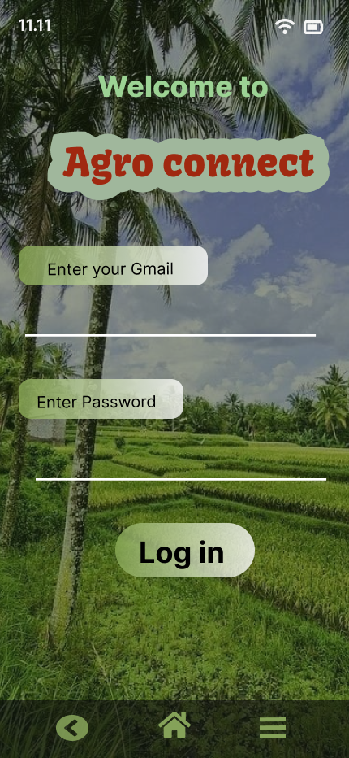
Output :
◻

Slide 10
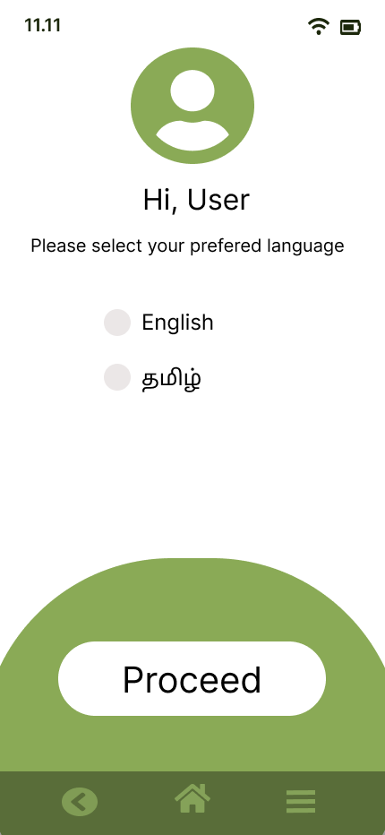
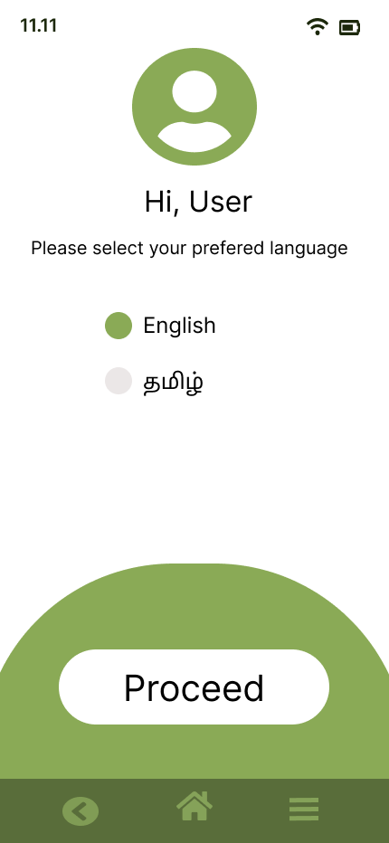
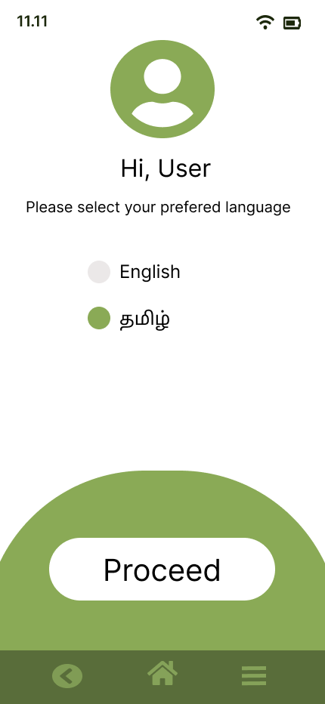

Slide 11
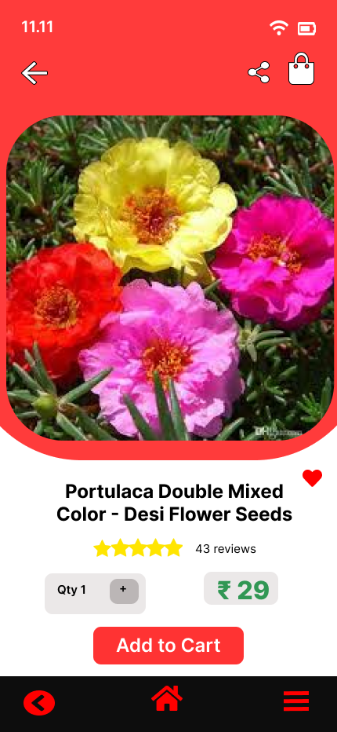
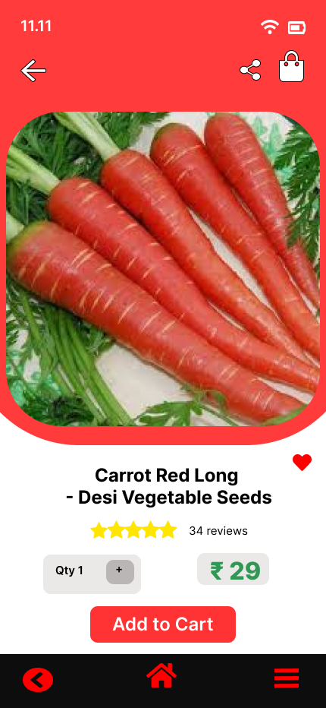
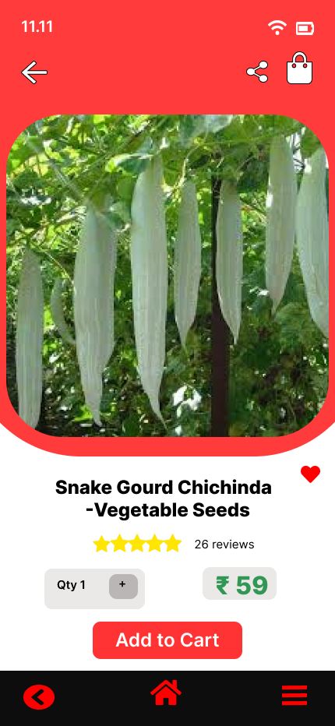

Slide 12
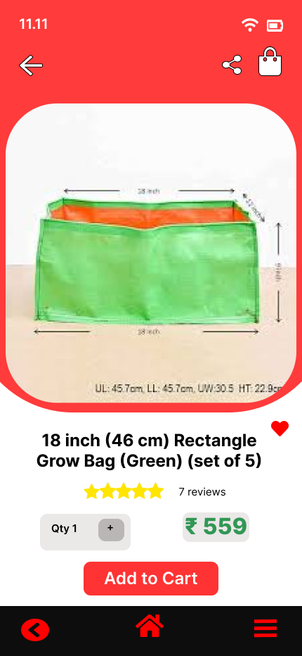
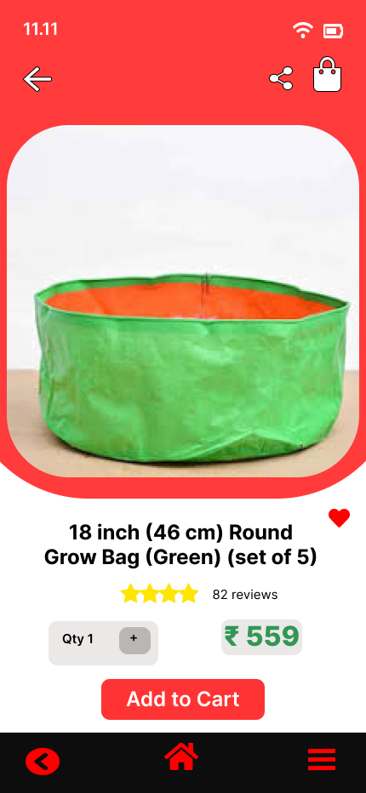
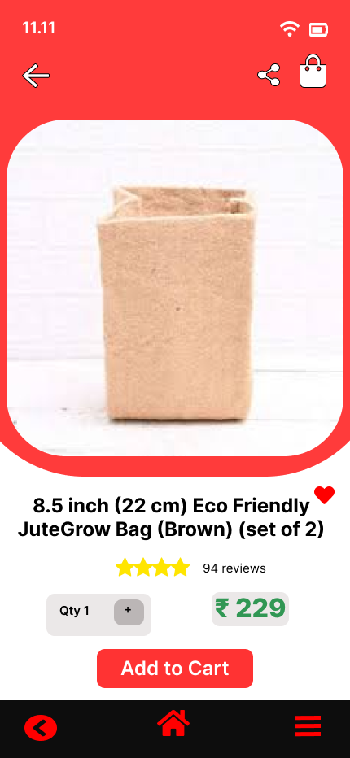

Slide 13
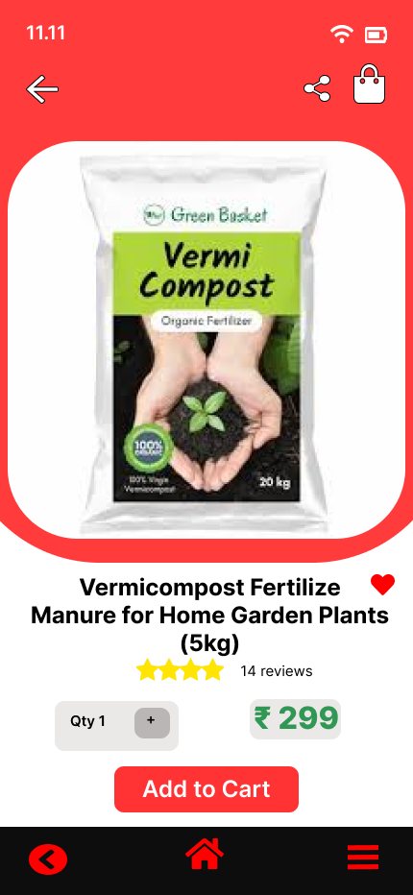
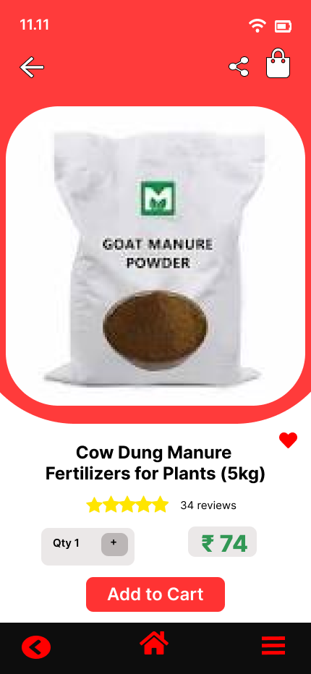
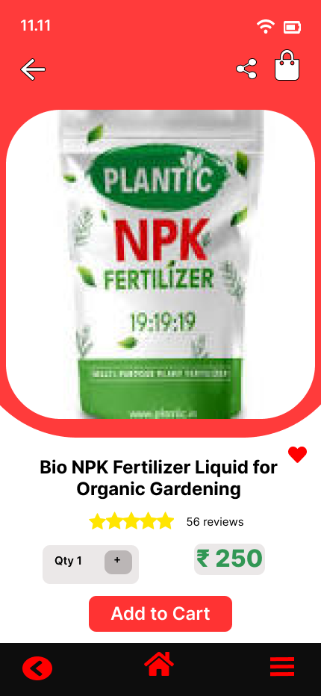

Slide 14
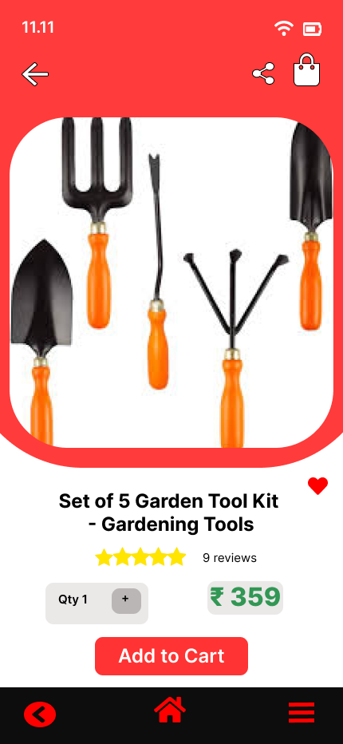
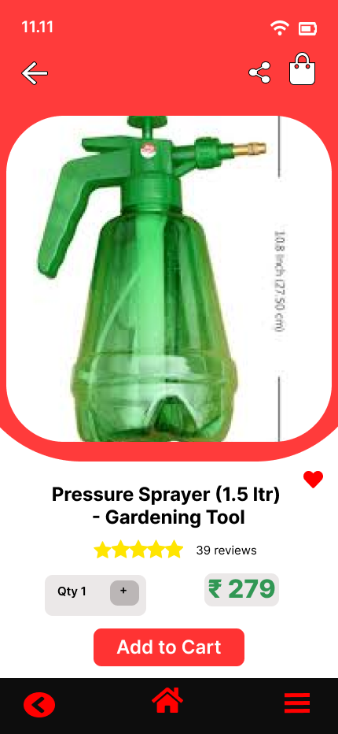


Slide 15
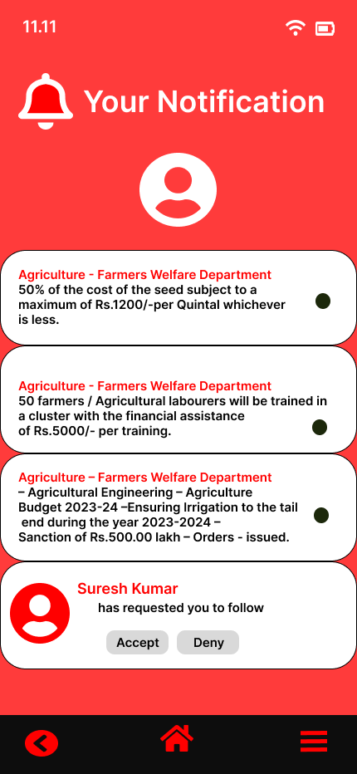
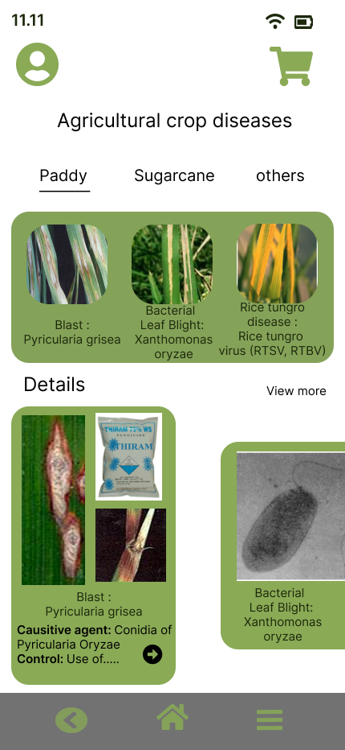

Slide 16
Future Scope
Mobile Application Development
Virtual Reality (VR) Training
Real-Time Market Prices
Networking Challenges
Weather Forecast Integration

Slide 17
THANK YOU!

